Slide 1
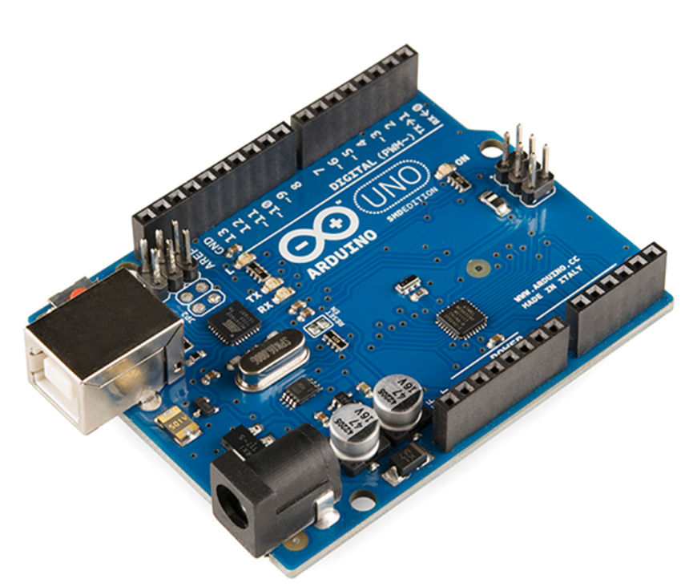
ARDUINO MICROCONTROLLER

Slide 2
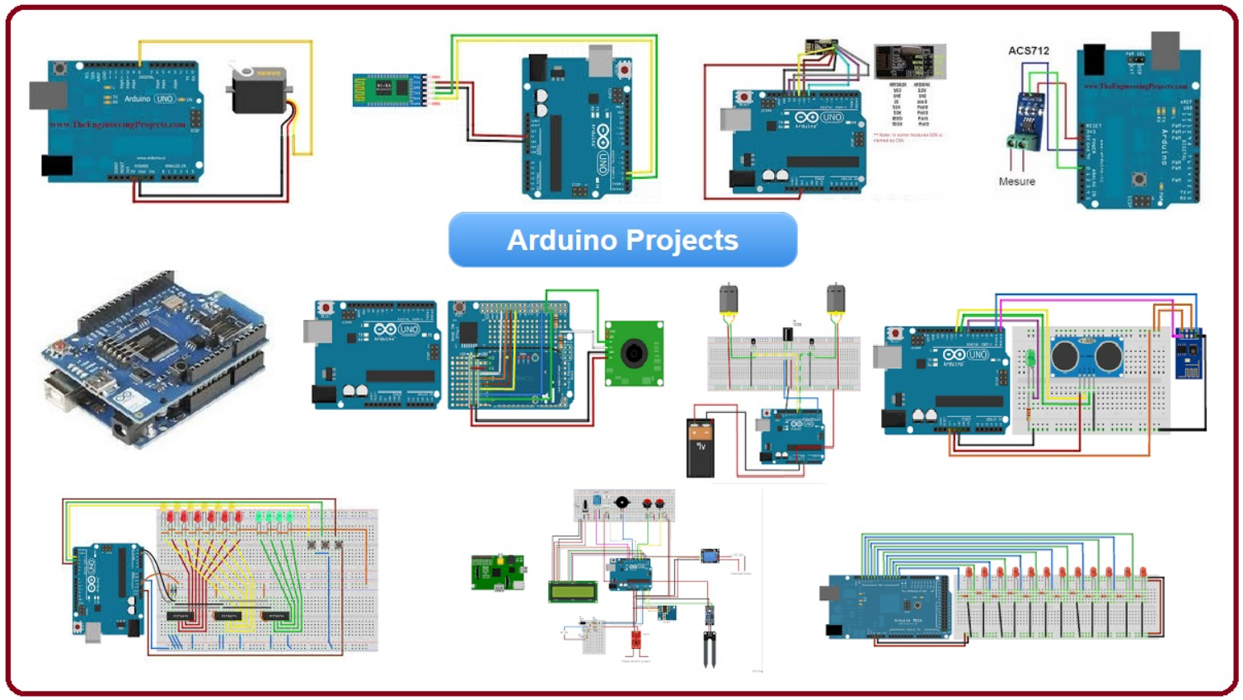
Projects
Σε αυτήν την παρουσίαση θα δείξουμε ορισμένα μεγαλύτερα projects που μπορούμε να πραγματοποιήσουμε συνδυάζοντας ότι μάθαμε στον προγραμματισμό Arduino.

Slide 3
Small Projects
Distance meter
Obstacle detector
Water level meter
Knock detection-door opening
Parking system
Piano
Music reactive led
Light sign(moving text)
Altitude/atmospheric pressure meter
Alcohol measurement
Traffic light
Alarm clock
Stopwatch
Clock

Slide 4
Smart home projects
Thermometer-Temperature controller
Smart light bulbs
Alarm system
Photocell
Smart lock
Magnetic lock
Smart garden
Smart water tank
Fire alarm/gas alarm
Temperature/humidity meter
Rain detection
Sun tracker
Clap switch
Remote control of devices

Slide 5
Games
Jumping jump game
Tetris
Pacman
Snake game
Flappy Bird

Slide 6
Larger projects
Christmas led tree
Robotic arm
Led cube
Radar
Bomb
Robotic hand
Smart barrier
Blind stick

Slide 7

THE END!

